Slide 1
Themes and Meditations on F# Type Providers Information-Rich Functional Programming for Internet-Scale Data Sources
Don Syme, Keith Battocchi, Jomo Fisher, Donna Malayeri, Kenji Takeda, Tomas Petricek and others
DDFP, 22 Jan 2012

Slide 2
F# and Open Source
F# is open source
Apache 2.0 license
fsharp.org
F# 3.0 now out
Free Open-Source Tooling
Mac, Linux, Windows, Browsers

Slide 3
Proposition 1 The Information Revolution

Slide 4
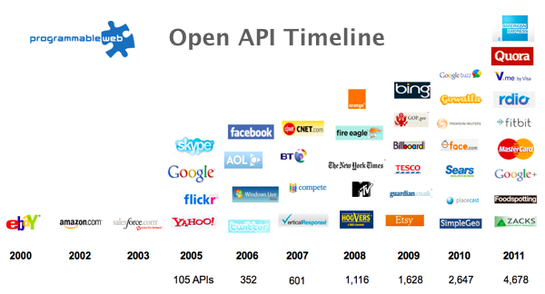
The Information Revolution

Slide 5
Proposition 2 Our languages are information-sparse

Slide 6
Proposition 3 This is a problem! (especially for strongly typed languages)

Slide 7
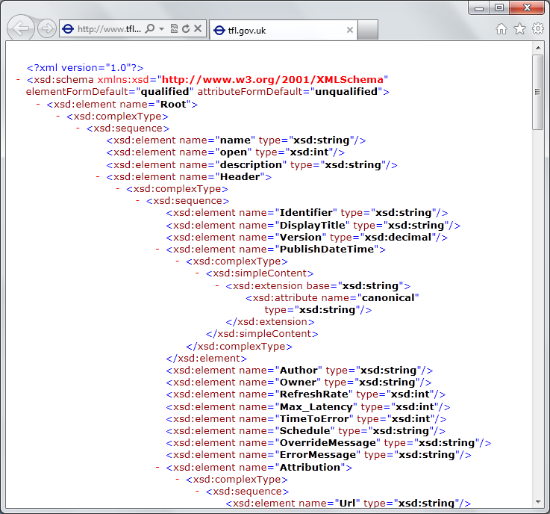
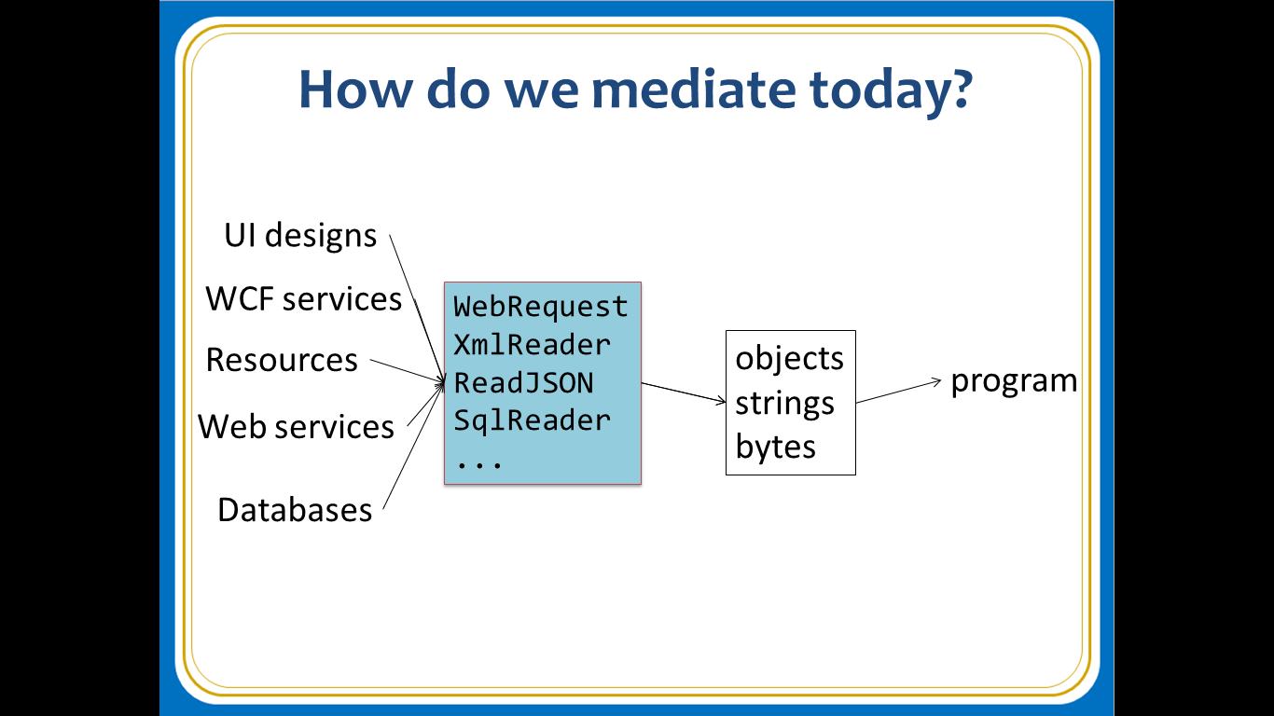
The problem…
Existing techniques have major problems
Over-reliance on code-generation
Do not scale
No tooling
No strong types
Lowest-common-denominator

Slide 8
Today (1) Demonstrate F# 3.0 (2) Themes in Scalable Information Rich Programming

Slide 9
Demo: A Challenge! Task #1: A Chemistry Elements Class Library Task #2: A Biology Class Library Task #3: Repeat for all fields of human knowledge and endeavour…

Slide 10
The approach…
An adaptor/provider model for “the outside world”
Integrate information spaces “directly”
A variation on compile-time meta-programming
Without the hell of macros
Scalable, on-demand expansion of symbols
Type erasure for scalability
Reuse visual language tooling
For discovery, navigation, documentation, …
Focus on *ity
usability, scalability, discoverability, productivity, robustness

Slide 11
Paradigm Locator
Statically Typed
Dynamically Typed

Slide 12
Paradigm Locator
Statically Typed
Dynamically Typed
The search is on!
make statically typed langs more dynamic
make dynamically typed langs more static
moderate static typing in limited ways

Slide 13
Example Providers
Freebase Provider (*)
World Bank Provider (*)
SQL Provider
OData Provider
WSDL Provider
CSV Provider (*)
JSON Provider (*)
XML Provider (*)
R Provider (*)

Slide 14
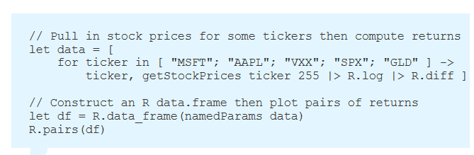
Example: RProvider
r provider f#
Open source community provider for interop with R
discovers installed R packages
Access > 2,000 R packages
projects them as .NET namespaces
underneath the parent namespace RProvider

Slide 15
Definition #1 Information-rich programming is where external schematized information sources are integral to the operation of the programs being constructed. These may be as simple as textual DSLs embedded as strings in the program itself, as familiar as SQL databases, as massive as a service exposing Wikipedia data, or the world-wide-web of HTML documents itself.

Slide 16
Definition #2 A (strongly-typed) information-rich programming language integrates external information sources, where the schema and content of these sources are presented in a (strongly-typed) idiomatic form

Slide 17
Recap: this is different…
“The idea of integrating internet-scale information services directly into the program's variable and type space that is in F# 3.0 is probably the most innovative programming language idea I have heard of in a decade” (Jim Cordy, Queens U., faculty summit 2012)
Perhaps, perhaps not…
But if something so simple is perceived as so different, it is worth taking a long think about why
We need to prise apart assumptions

Slide 18
Recap: this is different…
We like to see PL systems as logical systems
Traditional logical systems exclude interaction with reality
This is a powerful and simplifying assumption
It is also fundamentally wrong for modern applied programming languages

Slide 19


Γ $⊢ e$ : τ
Lots of work here
Lots of work here
The exclusion of reality
But what about here?
Γ₀ = 0

Slide 20
Meditations on Γ₀
Γ₀ is the ever-growing ocean of digital reality around us
Γ₀ is big. Really big.
You might think your hard disk is full, but that’s just peanuts to Γ₀
Γ₀ is other. It doesn’t speak your language
Γ₀ is being organized at an incredible rate
Γ₀ is just ready and waiting to be tamed. (We’re hitting the limit with e and tau)
Γ₀ is surprisingly “human”

Slide 21
Meditations on Γ₀
Γ₀ is full of uncertainty and probabilities.
You are mutually recursive with Γ₀. You are part of it.
Γ₀ has many open doors, many locked doors
Γ₀ has many, many parts that do not get on particularly well.
Γ₀ is so real you want to touch it, explore it
Don’t look too long.
It’s like staring at infinity

Slide 22
Theme #1 Big Data → Big Metadata Few existing programming languages are able to seamlessly integrate external internet-scale metadata in a scalable way. Strongly typed languages and tooling have a role here, surely!

Slide 23
Theme #2 A strongly-typed, functional-first language is an excellent starting point for strongly-typed information-rich programming “Best of FP + Best of OO” Type inference, H.O., Async, Queries, REPL, Meta-programming

Slide 24
Theme #3 Multiple Data Standards through One Simple Mechanism Rich type systems, importing rich metadata where it exists

Slide 25
Theme #4 Schema Change ☺ Example: see the paper and technical report…

Slide 26
Theme #5 Programming Type Systems v. Information Space Metadata Synergy or Conflict? Examples: Types, Schema, Constraints, Units of Measure, Security Information, Documentation, Definition Locations, Help , Provenance, Privacy, Ratings, Rankings, Search…

Slide 27
Some Research Questions
Can provided probabilistic metadata be useful for typing or tooling?
Can we design library/provider mechanisms which incorporate schema change policies?
Can we prove correctness or find bugs in provider components?
Can we provide all the data in the enterprise, wikipedia, bing or google?
Can we plug and play more language logic?
Can we provide and check richer constraints?
Can we build a truly heterogeneous language?
Can security, privacy and provenance annotations be provided?
Can we flow types into the providers?
Can we go mutually recursive?

Slide 28
Summary
heterogeneous data+services
language-integrated
without explicit codegen
strongly-typed
(up-to schema change)
extensible, open, on-demand
“just enough” meta-programming

Slide 29
Summary The world is information rich Programming needs to be information-rich too Type provider mechanisms can integrate information more seamlessly at scale than any other language

Slide 30
fsharp.net tryfsharp.org fsharp.github.com Questions?

Slide 31
Understanding F#
F# 1.0
F# 2.0
C# (designers)
F# (code)
WebSharper/
Javascript (HTML5)
F# 3.0
Code
Analysis
Algorithms
Parallel
Data
Information
Services
Presentation
Publication
UI

